Slide 1

Clean Code and More
SOLID / GRASP

Slide 2
Solid

Slide 3
SOLID
A collection of five guidelines collected by Robert C. Martin (Uncle Bob)
Single Responsibility Principle (SRP)
Open/Closed Principle
Liskov Substitution Principle
Interface Segregation Principle
Dependency Inversion Principle

Slide 4
class Point2D { private: float x, y;
public: float get_x() { return x; } float get_y() { return y; } void send_email(string to, string topic, string body) { // ... } com::obscure::db::Connection connect_to_database(string url) { // ... } // ... }

Slide 5
Single Responsibility Principle
For each class there should only be a single reason to change
The name is not quite correct: SRP does not state that each class may only have a single responsibility
Closely connected to high cohesion / low coupling
(Complementary to Information Expert from GRASP)

Slide 6
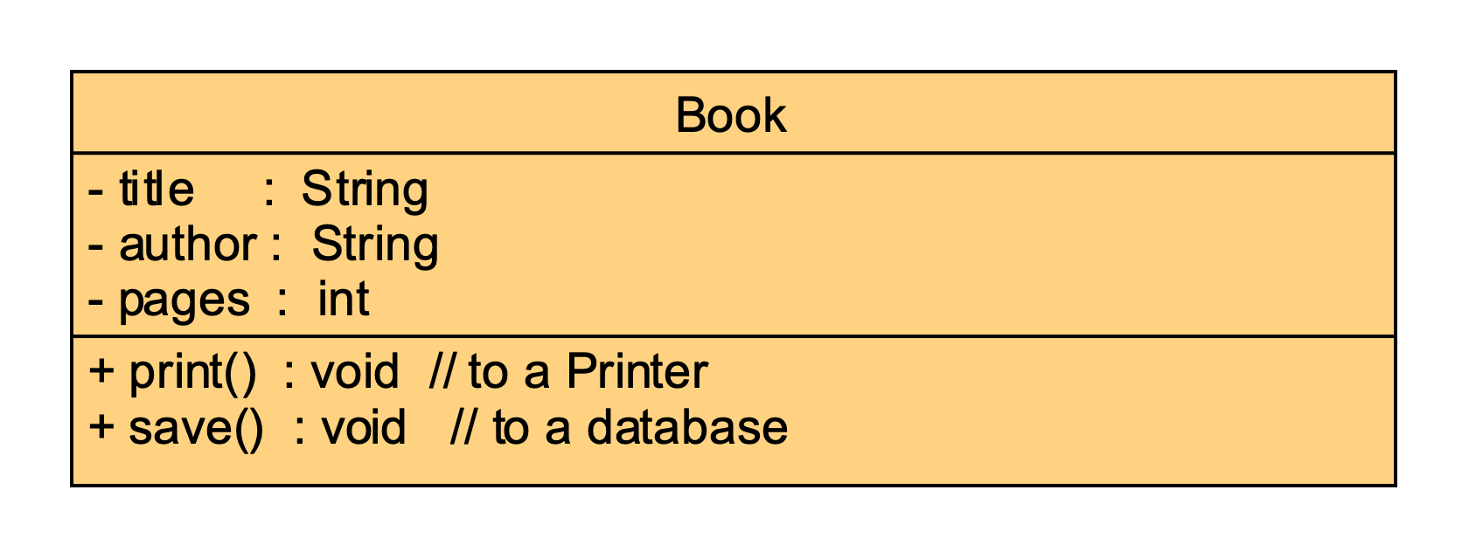
Single Responsibility?

Slide 7

Where is the Problem?

Slide 8
violation of Single Responsibility Principle

Slide 9
class Book { private: std::string title; std::string author; private int pages;
public: Book(std::string title, std::string author, int pages) {…} void print(){ std::cout << "Printing : " << this << std::endl; } void save(){ std::cout <<"Saving " << this << " to database...\n"; } std::string to_string() { … } }

Slide 10
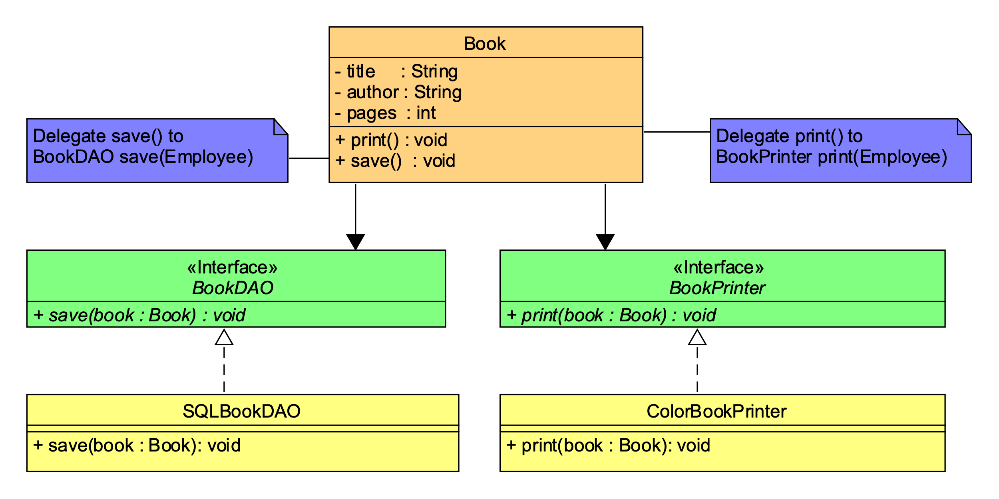
Resolve the SRP-Violation I

Slide 11
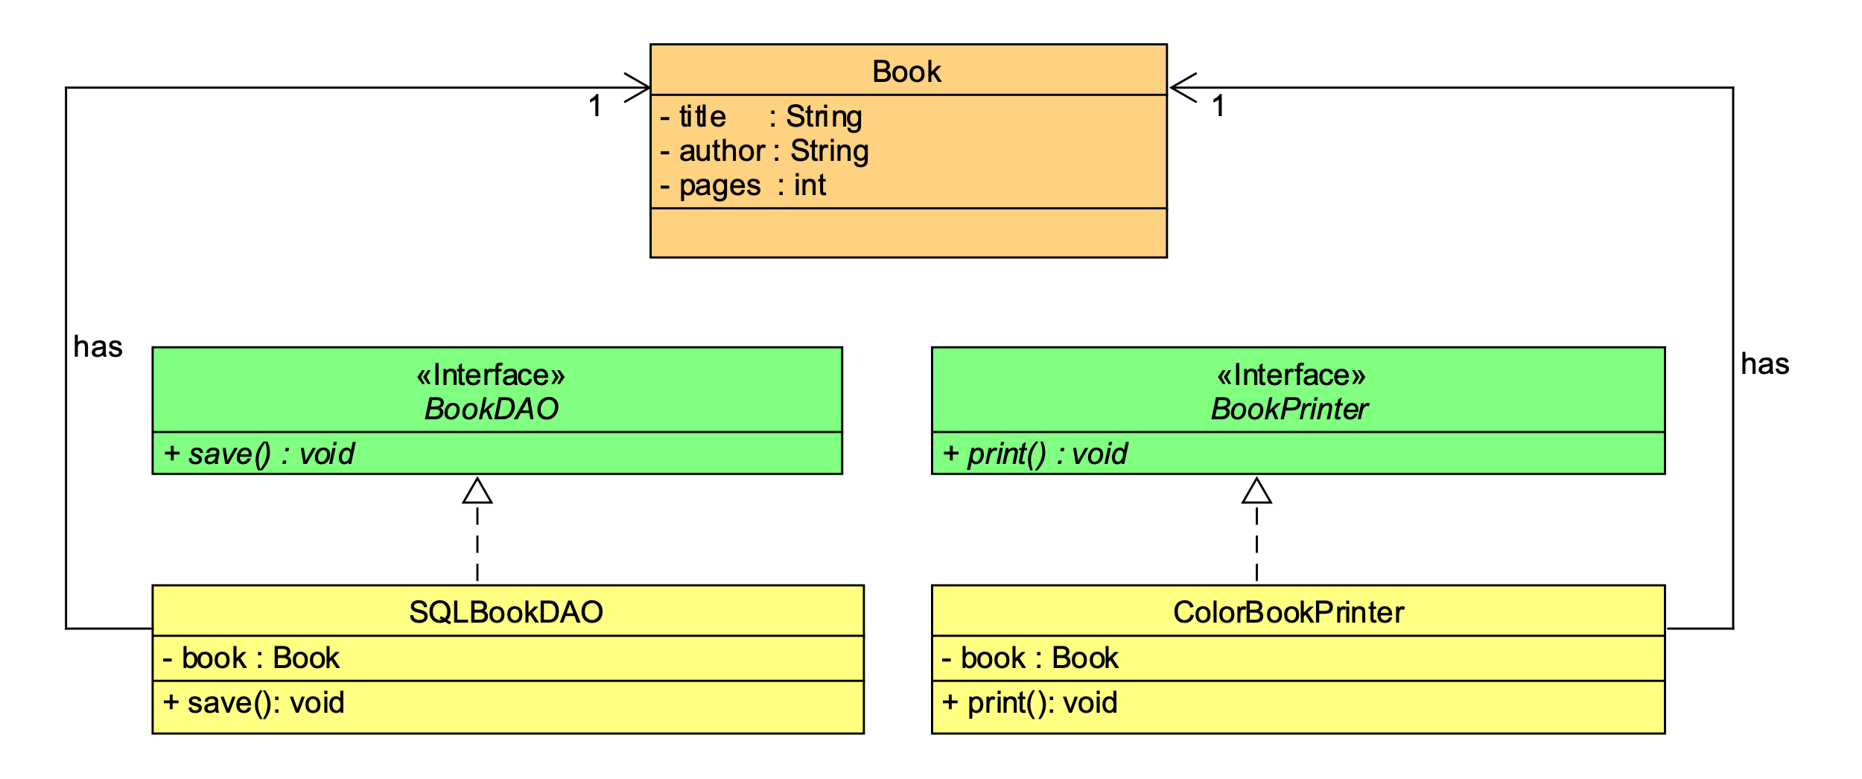
Resolve the SRP-Violation II

Slide 12
Resolve the SRP-Violation I vs. II

Slide 13
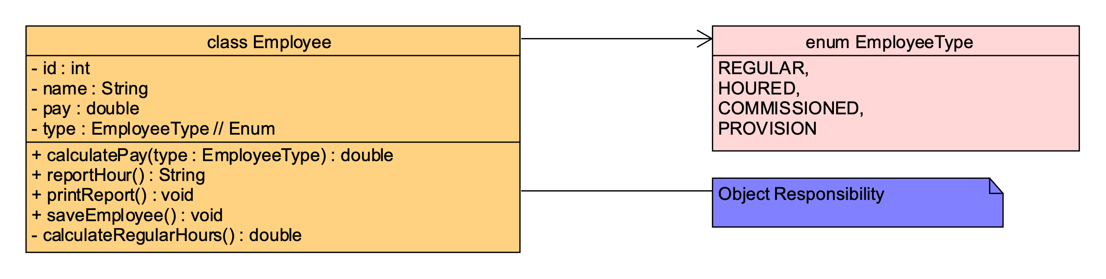
Single ResponsiBILITY?

Slide 14
What is the Problem?

Slide 15



SRP Violation
class Employee
Accounting Department
+ calculatePay
+ reportHours
Human Resources Department
+ printReport
Database Administrators
+ saveEmployee
- regularHours

Slide 16
SRP-Violation
class Employee
+ calculatePay
+ reportHours
- regularHours
+ saveEmployee

Slide 17
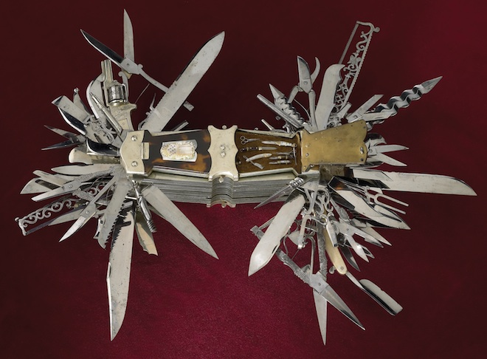
SRP Violation
A system that consists of objects with too many states has a rigid and fragile design!

Slide 18
SRP-Violation: Solution Proposal I
class Calculator
Accounting Department
+ calculatePay
class HourReporter
class EmployeeData
HR Department
+ reportHours
class EmployeeSaver
Database Administrators
+ saveEmployee

Slide 19
SRP-Violation: Solution Proposal II (Facade-Pattern)
class Calculator
+ calculatePay
class EmployeeFacade
+ calculatePay
+ reportHours
+ saveEmployee
class EmployeeData
class HourReporter
+ reportHours
class EmployeeSaver
+ saveEmployee

Slide 20
SRP-Violation: Solution Proposal III
class HourReporter
class Employee
- employeeData
+ calculatePay
+ reportHours
+ saveEmployee
+ reportHours
class EmployeeSaver
+ saveEmployee

Slide 21
Open/Closed Principle
Software artifacts (classes, modules, functions, etc.) should be open for extension but closed for change
More simply: it should be possible to modify the behavior of objects or introduce new kinds of objects without touching the existing code
More concretely:
Implementation against interfaces, not concrete classes
Use of method overriding (polymorphism) instead of if or switch statements
(No use of checked exceptions)
More general: Protected Variation, Information Hiding

Slide 22
class Shape { | virtual void draw() = 0; | } | | class Ellipse : public Shape { | class Circle : public Shape { public: | public: virtual Point2D get_focus1(){} | virtual Point2D get_center(){} virtual Point2D get_focus2(){} | virtual double get_radius(){} virtual float get_diameter(){} | | void draw() override { /* … */ } void draw() override { /* … */ } | } |

Slide 23
Liskov Substitution Principle
Instances of subclasses can take the role of superclasses without changing program behavior
More relaxed version: without causing problems
This is a fundamental feature of class hierarchies

Slide 24
Interface Segregation Principle
No client of a class C should depend on methods it doesn’t use
If that is not the case
Divide the interface of C into multiple independent interfaces
Replace C in each client with the interfaces actually used by the client

Slide 25
Dependency Inversion Principle
The core functionality of a system does not depend on its environment
Concrete artifacts depend on abstractions (not vice versa)
Unstable artifacts depend on stable artifacts (not vice versa)
Outer layers of the architecture depend on inner layers (not vice versa)
Classes/Modules depend on abstractions (e.g., interfaces) not on other classes/modules
Dependency inversion achieves this by introducing interfaces that “reverse the dependencies”

Slide 26
Bad Dependency
Business Rule
Database
depends on

Slide 27
Dependency Inversion (Step 1)
Business Rule
Database
depends on
depends on
Database Interface

Slide 28
Dependency Inversion (Step 2)
Business Rule
Database
depends on
depends on
Database Interface
Database Adapter
depends on

Slide 29
Workshop
The Employee project contains an implementation of a class Employee that violates many of the SOLID principles:
It has more than one reason to change (report, database)
Some dependencies go in the wrong direction (database)
It doesn’t follow the Open/Closed principle
Clean up the code so that these violations are no longer present.

Slide 30
Notes:
Grasp
General
Responsibility
Assignment
Patterns

Slide 31
Grasp

Slide 32
GRASP
General Responsibility Assignment Software Patterns
A collection of patterns, practices and principles published by Craig Larman

Slide 33
GRASP
High Cohesion
Low Coupling
Information Expert
Creator
Controller
Polymorphism
Pure Fabrication
Indirection
Protected Variations

Slide 34
Notes:
Hohe Kohäsion, niedrige Kopplung
Kohäsion: Ein Maß dafür, wie gut Teile (Module, Klassen, …) zusammenarbeiten
Funktional, Daten
Kohäsion existiert auf verschiedenen Ebenen
Hohe Kohäsion erleichtert
Evolution des Codes/Packages/etc.
Wiederverwendung
Testbarkeit
Hohe Performanz
Mangelnde Kohäsion
Macht Code schwer zu verstehen
Macht es schwer herauszufinden, wo Änderungen vorgenommen werden müssen

Slide 35
High Cohesion
Measures how well different parts of an artifact fit together
High cohesion simplifies evolution, reuse, testing, performance
Low cohesion makes it difficult to understand the code or to figure out where to make changes
The negative effect of low cohesion is large
It is difficult to move a system with low cohesion to a state where it has more cohesion
Code smells: shotgun surgery, divergent change
Related: SRP, Command/Query Separation

Slide 36
Notes:
Der negative Effekt von niedriger Kohäsion ist groß
Es ist schwer ein System mit geringer Kohäsion in eines mit hoher Kohäsion umzuwandeln
Daher sollte hohe Kohäsion von Anfang an ein wesentlicher Aspekt bei der Entwicklung sein
Siehe Code Smells: Shotgun Surgery, Divergent Change
Verwandt:
Schichtenarchitektur, Hexagonale Architektur
Command/Query Separation
Single Responsibility Principle
Separation of Concerns

Slide 37
High Cohesion and Tests
Low cohesion causes the system functionality to be “smeared” over the whole system
This often leads to high coupling and large classes
These classes are difficult to move into a desired state
“Smeared functionality”
Makes unit testing difficult
Forces the use of many test doubles
Reduces the value of unit tests as documentation

Slide 38
Notes:
Niedrige Kopplung:
Kopplung: Ein Maß für die Abhängigkeit zwischen verschiedenen Softwarekomponenten (Modulen, Klassen, etc.)
Kopplung existiert für Daten, Operationen, Namen, etc.
Niedrige Kopplung ist erstrebenswert von
Stabilen Komponenten an instabile Komponenten
Inneren Ringen an äußere Ringe der hexagonalen Architektur
Hohe Kopplung (an die falschen Komponenten)
verhindert, dass man Teile des Systems in Isolation versteht
führt dazu, dass jede Änderung weitere Änderungen an großen Teilen der Codebasis nach sich zieht

Slide 39
Low Coupling
Coupling: measure of dependencies between different artifacts
Exists for data, operations, names, etc.
Low coupling is desirable from stable components to unstable components
High coupling
Prevents us from understanding parts of the system in isolation
Causes every change to proliferate throughout the system

Slide 40
Notes:
Hohe Kopplung an stabile Komponenten (z.B. Standardbibliothek) ist unvermeidlich und kein Problem
Hohe Kopplung auf lokaler Ebene ist typischerweise leicht zu beseitigen und daher kein besonders großes Problem
Hohe Kopplung in einem großen Kontext oder auf Architekturebene ist schwer zu beseitigen und sollte daher ein wesentlicher Aspekt bei der Entwicklung sein
Siehe Code Smells: Shotgun Surgery, Divergent Change
Verwandt:
Dependency Inversion Principle
Indirection
Law of Demeter

Slide 41
Low Coupling
High coupling to stable components (e.g., the standard library) is impossible to avoid and not a problem
High coupling on a local level is typically easy to remove and not a big problem
High coupling on a large context or in the architecture is difficult to remove and thus a major concern when developing software
Code smells: Shotgun Surgery, Divergent Change
Related: Dependency Inversion Principle, Law of Demeter

Slide 42
Notes:
Hohe Kopplung erschwert das Testen:
Abhängigkeiten müssen z.B. durch Dependency-Injection exponiert werden um das System überhaupt testbar zu machen
Es müssen für jeden Test viele Klassen instanziiert werden (→ Setup Sermon)
Die Abhängigkeiten müssen durch Test-Doubles aufgebrochen werden, daher werden zu viele Test-Doubles benötigt

Slide 43
High Coupling and Testing
High coupling makes testing difficult:
Dependencies have to be isolated using Dependency Injection to make the system testable
Many classes have to be instantiated for each test (see: Setup Sermon)
Many test doubles are necessary to break dependencies

Slide 44
Responsibility-Driven Design

Slide 45
Intermission: Responsibility-Driven Design
Low cohesion and high coupling are two major problems of many software systems
One way to work against these effects is to consciously assign responsibilities to classes and modules (responsibility-driven design)

Slide 46
Notes:
Information Expert – Single Responsibility
Services/Operationen sollen bei den Daten sein, auf denen sie operieren
Finde den „Informationsexperten“ der diese Daten hat und füge die Funktionalität zu ihm hinzu
Verwandt:
Kapselung, abstrakte Datentypen
Tell, don’t ask
Motiviert durch hohe Kohäsion und niedrige Kopplung
Testen:
Kombination von Daten und Operationen erleichtert das Unit-Testen

Slide 47
Information expert
Services / operations should be close to the data on which they operate
Find the “information expert” that keeps this data and add the functionality there
Related: encapsulation, abstract data types; tell, don’t ask; cohesion, coupling
Testing: combination from data and operations simplifies unit testing

Slide 48
Intermission: Tell, Don’t Ask
Decisions and activities that depend only on the state of object X should be performed by X itself
“Tell, don’t ask” doesn’t mean that queries should be replaced by commands!

Slide 49
Notes:
Creator - Factory
C (der Creator) erzeugt ein X wenn
C X enthält (als Aggregation)
C der einzige Nutzer von X ist
C die Daten zur Initialisierung von X enthält
Gewisser Widerspruch

Slide 50
Creator
An object C (the creator) creates an object X if
C contains X as aggregation
C is the only user of X
C holds the data to initialize X

Slide 51
Notes:
Verwandt:
Dependency Injection (als Alternative)
Factory (Alternative)
Verhältnis zum Testen
Ambivalent

Slide 52
Creator
Related: dependency injection (as alternative)
Relationship to testing: neutral/ambivalent

Slide 53
Notes:
Controller – Fassade
Verarbeitet “externe” Nachrichten
Gehören nicht zum Benutzerinterface (1. Objekt nach UI)
Repräsentieren Teilsystem
Use Case Controller – Verarbeitet ganzen use case
Tests: Controller stellen eine zentrale Schnittstelle von Tests für einzelne Komponenten oder Use-Cases dar
Controller – Mediator (manchmal)

Slide 54
Controller
For each module/subsystem: external messages are handled by Controller objects that
Are not part of the UI
Cover one subsystem or use case each
The controller is the first object after the UI to handle events/messages. It coordinates the system.
The controller is a façade, i.e., it delegates its work to other objects.
A use-case controller always processes a complete use case (but controllers can process more than one use case).

Slide 55
Controller
Related: façade pattern (domain façade), domain controller
See hexagonal architecture: Controllers are the ports in the hexagonal architecture.
Tests: controller provide a central interface for single subsystems or use cases

Slide 56
Notes:
Polymorphe Operationen: beschreiben ähnliche aber nicht identische Verhalten, die sich pro Typ ändern
Typischerweise keine Veränderung des Verhaltens eines Objekts zur Laufzeit
Verwandt:
Typ-Hierarchie-Design Regeln
Isa-Rule
Nur Blätter sind konkret)
Erzwinge Invarianten der Unterklassen in der Oberklasse
Liskov-Substitutionsprinzip (LSP)
Open/Closed Principle

Slide 57
Polymorphism
Polymorphic operations describe similar (but not identical) behaviors that may change depending on the type of an object
Typically no switch between behaviors during run-time
Related: Type-hierarchy rules (isa-rule, only leaves are concrete, enforcement of invariants for subtypes by supertype)
See also: LSP, Open/Closed principle

Slide 58
Notes:
Pure Fabrication
Most Patterns – No relation to domain
Advantage – Decoupling, abstraction
Disadvantage - More complexity, more difficult to understand

Slide 59
Pure Fabrications
A class that does not appear in the domain model
Typically a counterweight to the Information Expert that wants to concentrate functionality in a single class
Example: Database-functionality in domain classes Consistent with Information Expert But: low cohesion, high coupling Introduction of Data Access Objects (a pure fabrication)

Slide 60
Notes:
Indirection: Most Patterns
Observer
Strategy
Factory
Adapter

Slide 61
Indirection
“Every problem in computer science can be solved by adding another layer of indirection” – David Wheeler “Except too many layers of indirection” – N.N.
This is a very frequent pattern

Slide 62
Indirection
Very frequent pattern on every layer
Operating system
Virtual machines
Polymorphic method calls
Testing:
Indirections are seams that can be used for testing purposes

Slide 63
Notes:
Protected Variations
Privater State, Getter, Setter
Interfaces
Patterns: Factory, Observer, Strategy,

Slide 64
Protected Variations
How do we design components so that variation or evolution points don’t have an undesirable impact on other components?
Another ubiquituous mechanism

Slide 65
Protected Variations
Solution:
Identify the points where variation or evolution may occur
Introduce a stable interface protecting these points
These interfaces are frequently pure fabrications
Often these interfaces introduce an indirection

Slide 66
Protected Variations
Very frequently applied:
Private attributes with getters/setters
Interfaces, polymorphism
Virtual Machines
Standards
Protected Variations are often entry points for tests
But often additional tests have to be written to ensure that the system still works when the variability is actually used

Slide 67
SOLID vs. Grasp
Single Responsibility - Information Expert
Open/Closed - Polymorphism(?)
LSP - Polymorphism
Interface Segregation - Controller(?)
Dependency Inversion - High Cohesion
Dependency Inversion - Low Coupling

